Slide 1

Final video presentation(bax 421)
Ruiyuan Yang

Slide 2
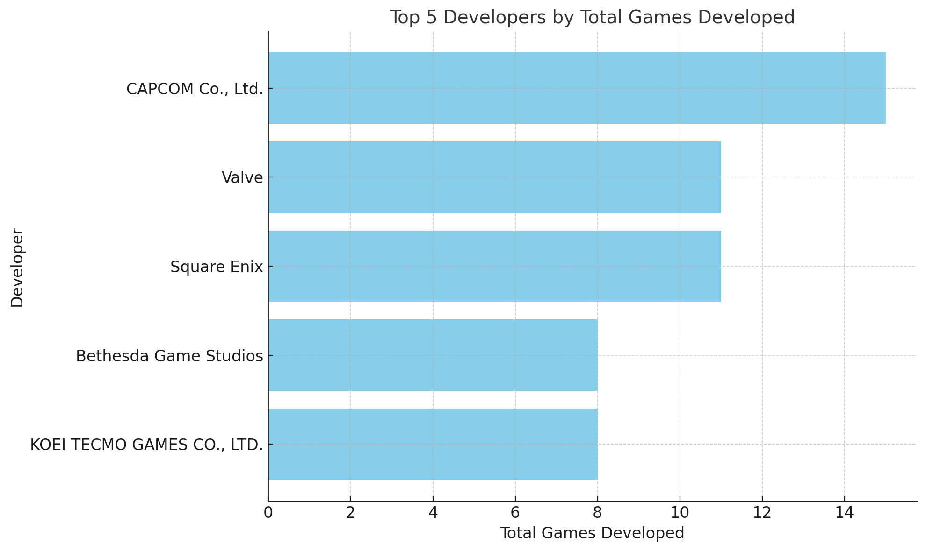
Question 1：
Which developer has worked on the most games(select top5)?
This data indicates that CAPCOM is significantly active in game development compared to its peers, and a strong focus by these top developers could hint at their influence and footprint in the gaming industry.

Slide 3
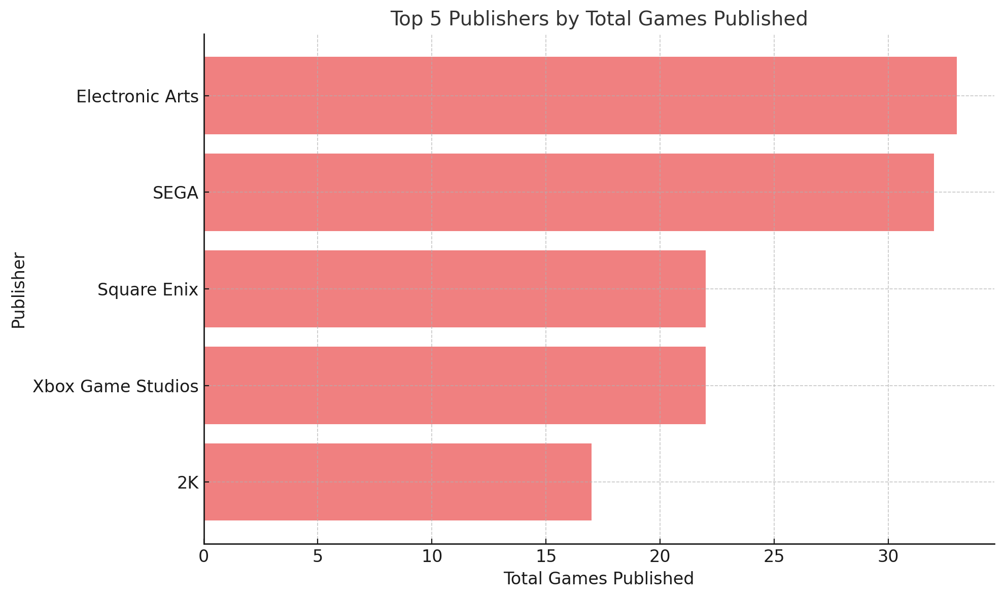
Question 2：
Which publisher has worked on the most games(select top5)?
This data highlights Electronic Arts and SEGA as dominant publishers in the industry, while other publishers like Square Enix and Xbox Game Studios maintain a significant but slightly smaller catalog. These leaders likely cater to diverse player bases with a wide range of games.

Slide 4
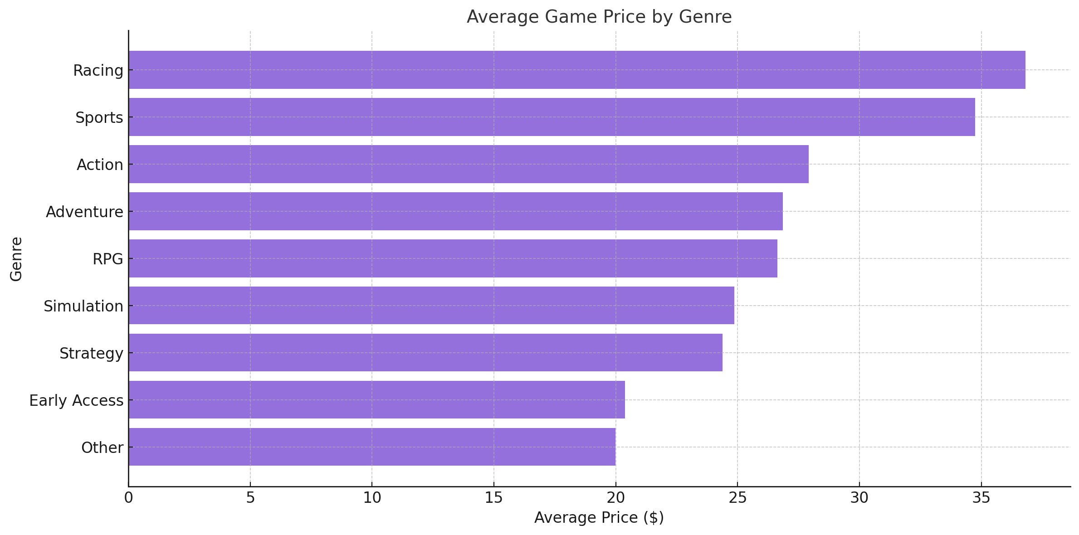
Question 3：
What is the average price of each genre of game?
This breakdown indicates that high-energy genres like Racing and Sports tend to have premium pricing, potentially reflecting higher production costs or greater perceived value by players. Meanwhile, more niche or casual genres are priced lower, appealing to a broader, price-sensitive audience

Slide 5
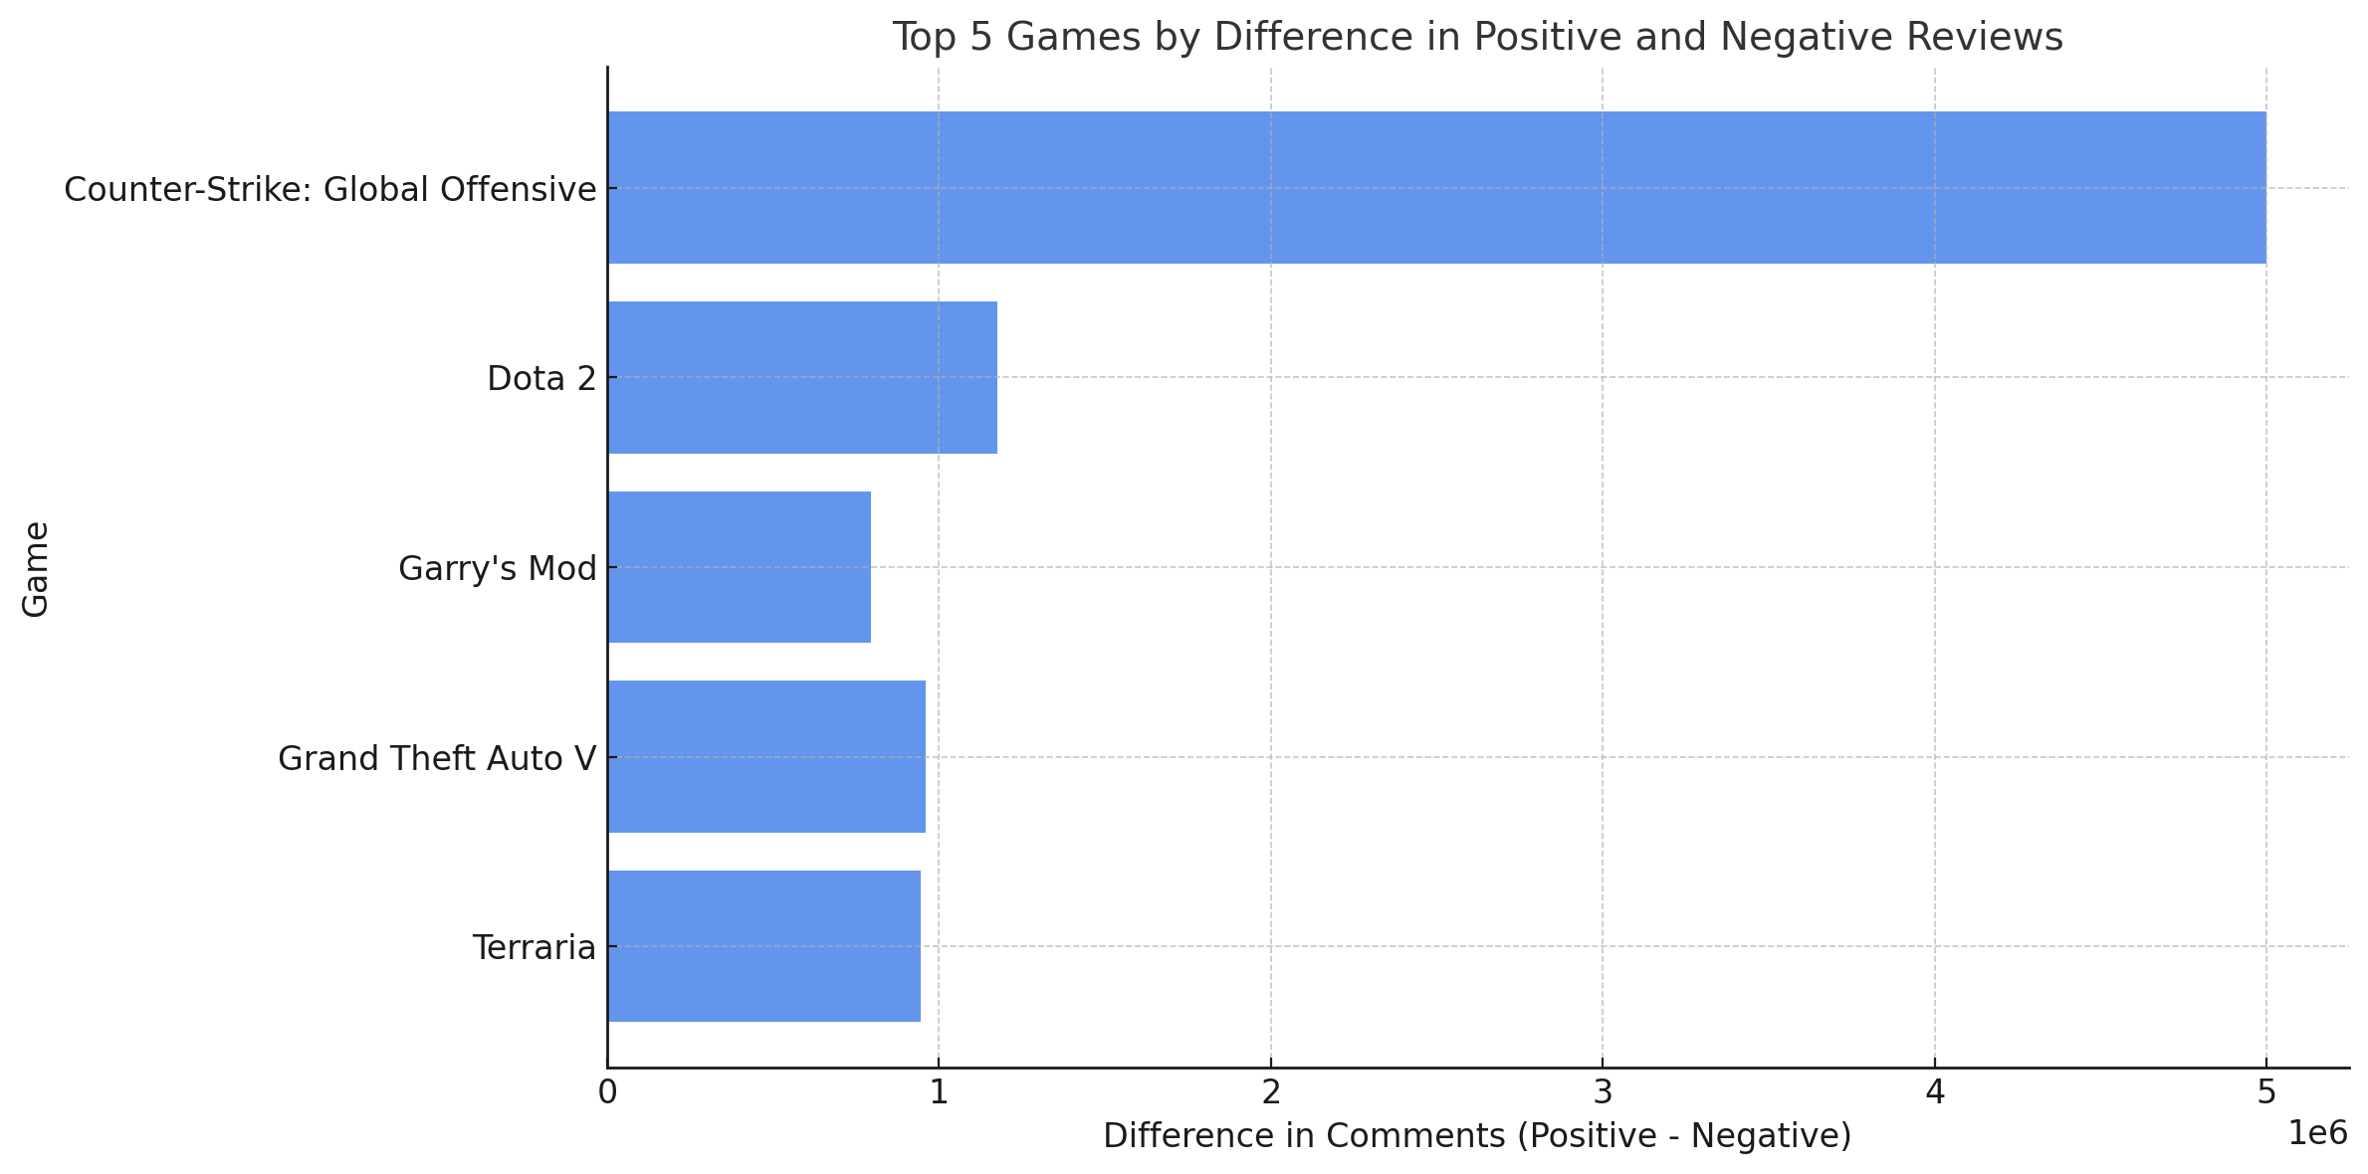
Question 4：
Which game has the greatest difference between positive and negative reviews and its genre?
This data suggests that games with broader genres and replayable gameplay elements tend to generate substantial positive feedback, highlighting their long-term popularity in the gaming community. ​

Slide 6
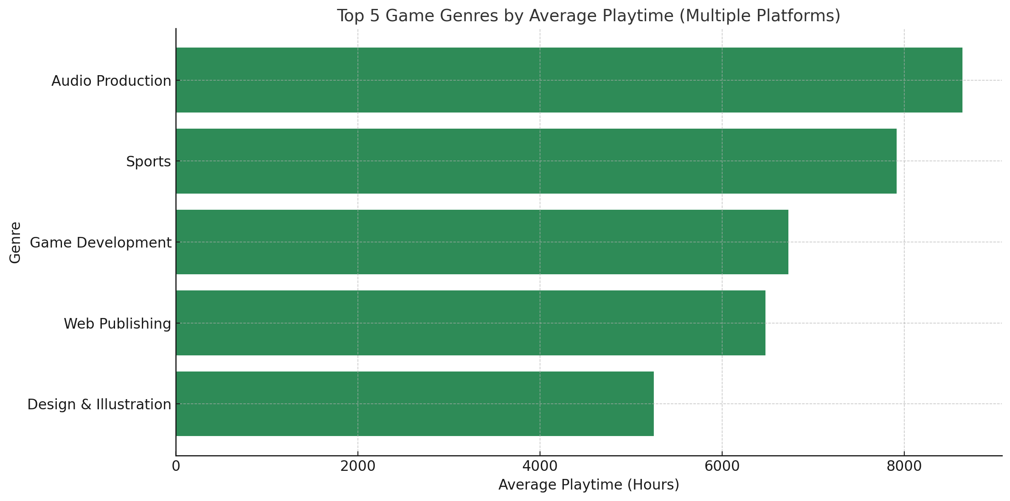
Question 5：
For games that support multiple platforms, which game types (Genres) have the longest average playtime (Playtime)?
This data highlights that genres with creative, utility, or competitive elements tend to have higher average playtimes, likely due to their inherently replayable or long-term usage nature.

Slide 7
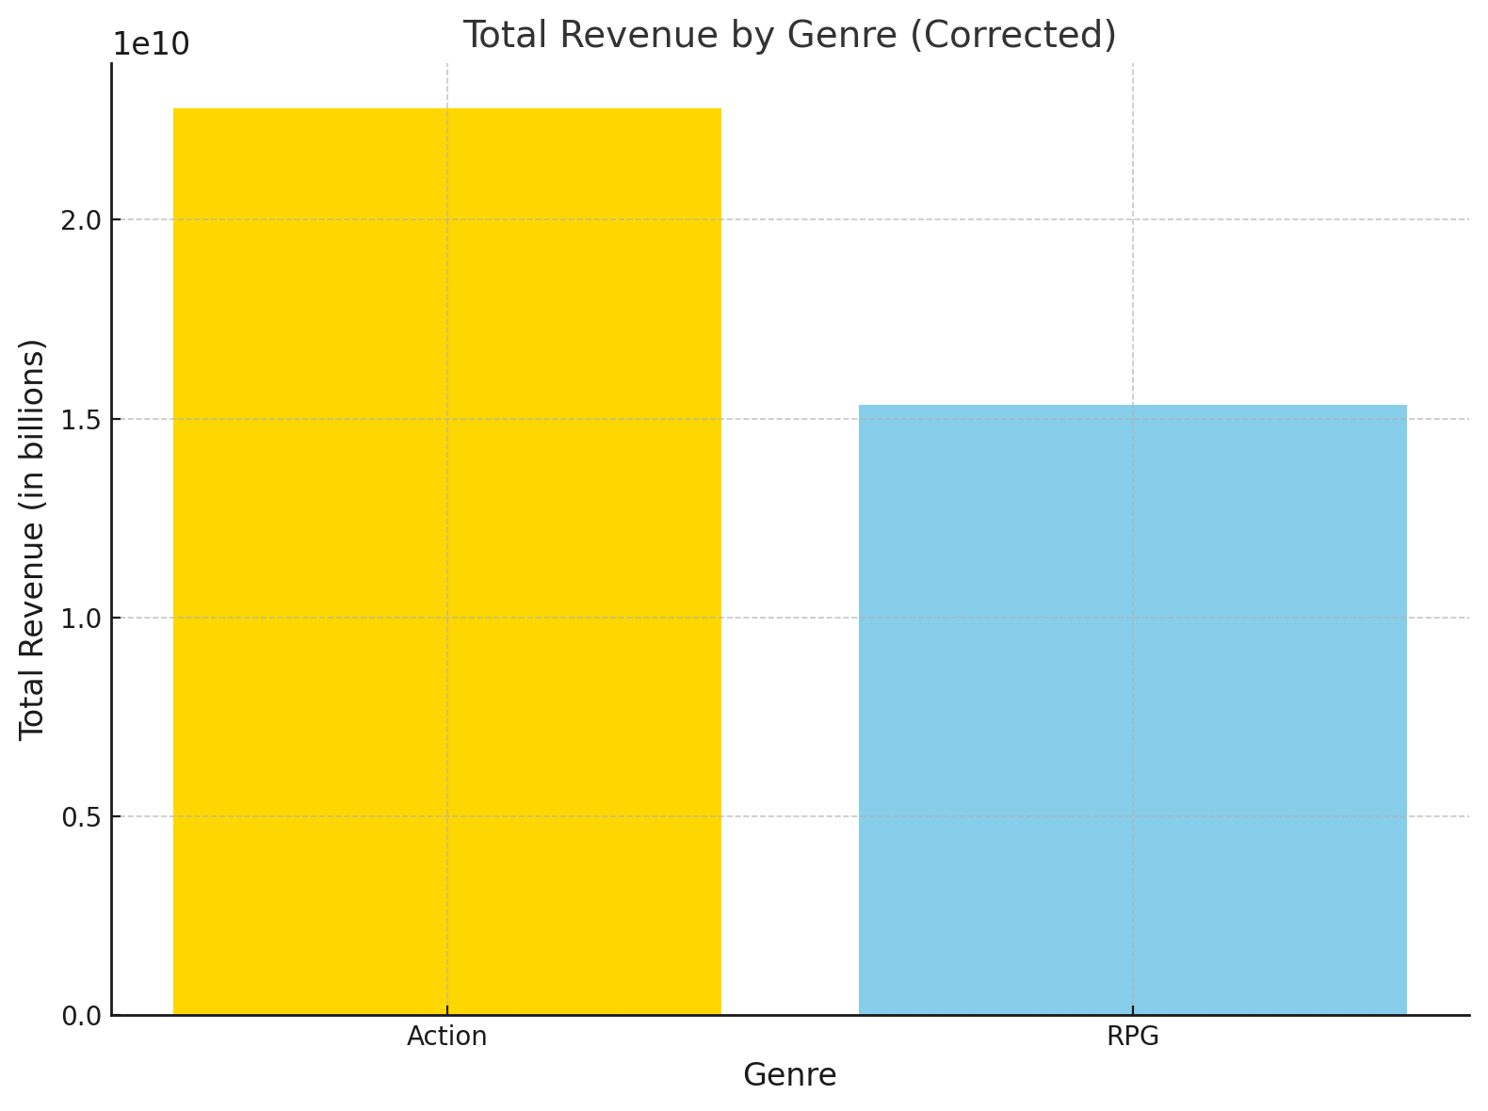
Question 6：
Which genres have the highest gross revenues? Which genres contribute the top 50% of total revenue?
Action games and RPGs together contribute more than 50% of the total revenue in the dataset. The combined dominance of these two genres highlights their crucial role in driving overall game industry revenue. These genres likely appeal to a wide range of players, balancing engaging gameplay (Action) and immersive storytelling (RPGs).

Slide 8
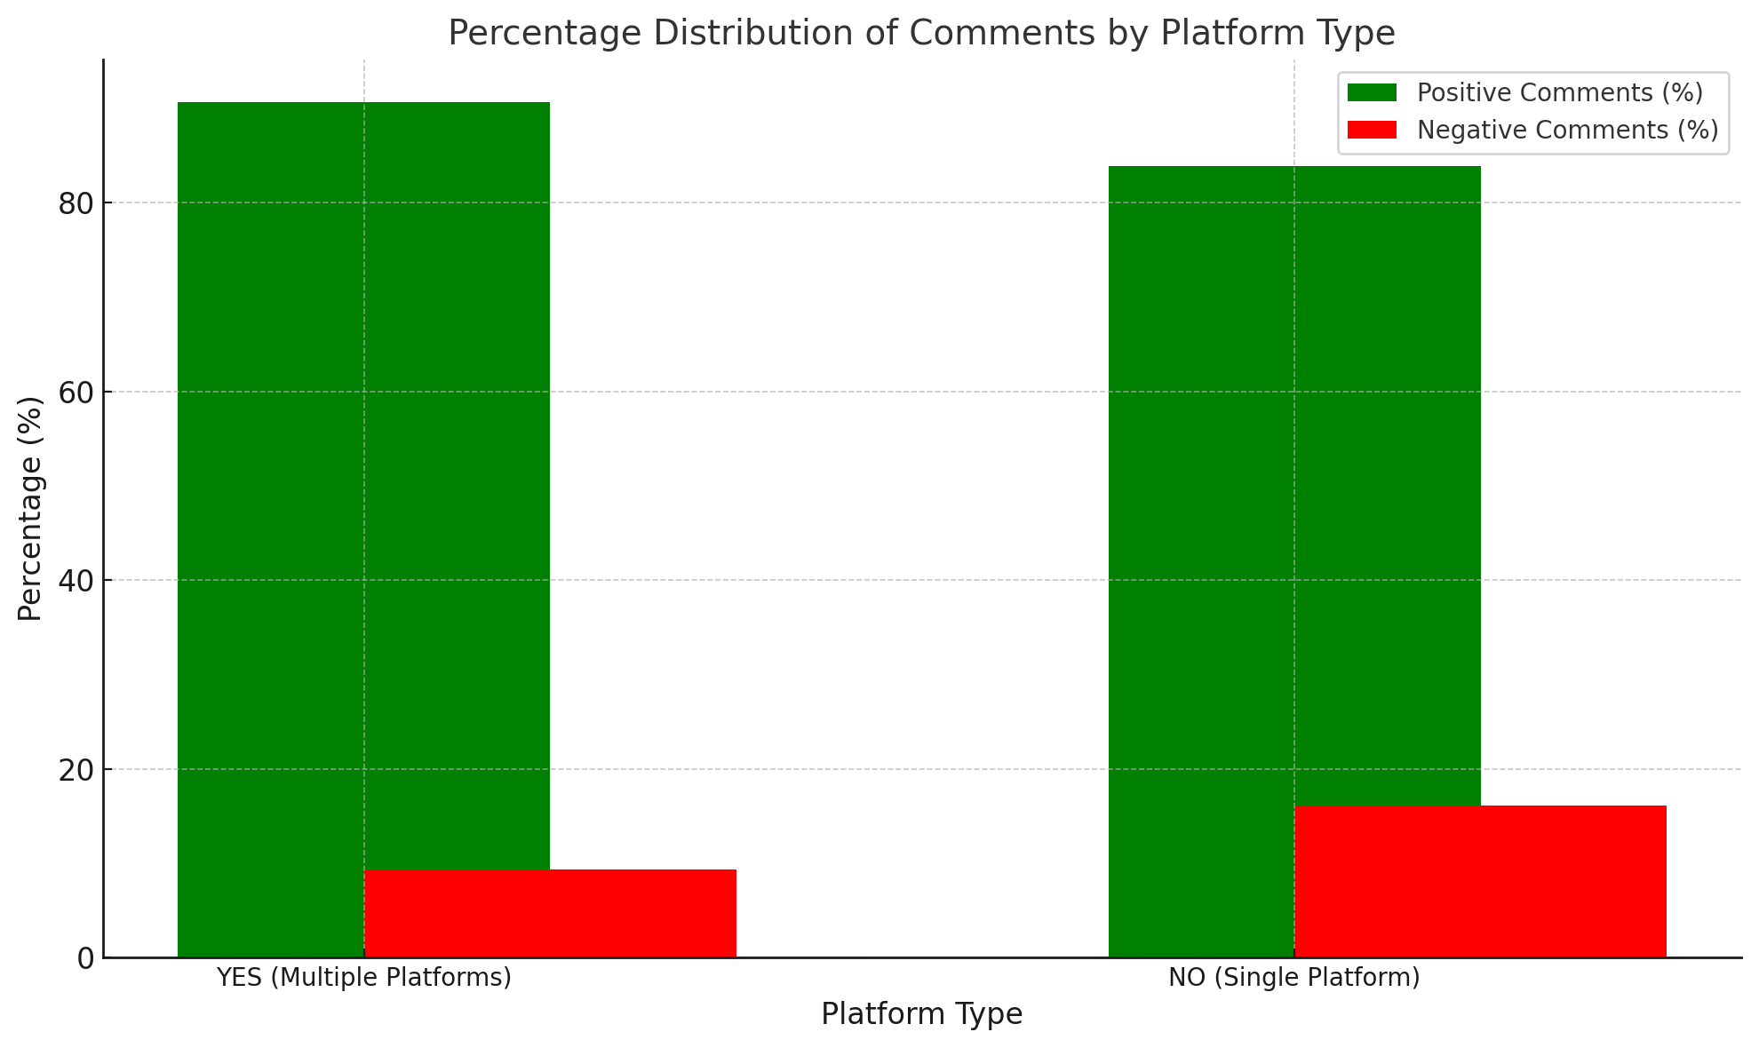
Question 7：
What is the percentage distribution of positive and negative reviews among the games supported by only one platform or multiply ones?
Games on multiple platforms have a significantly higher percentage of positive comments (90.68%) compared to negative comments (9.32%).Games on single platforms show a lower positive comment percentage (83.88%) and a higher proportion of negative comments (16.12%).This suggests that games available on multiple platforms tend to receive more favorable feedback, potentially due to broader accessibility and a larger player base, while single-platform games might face more criticism or limited exposure.

Slide 9
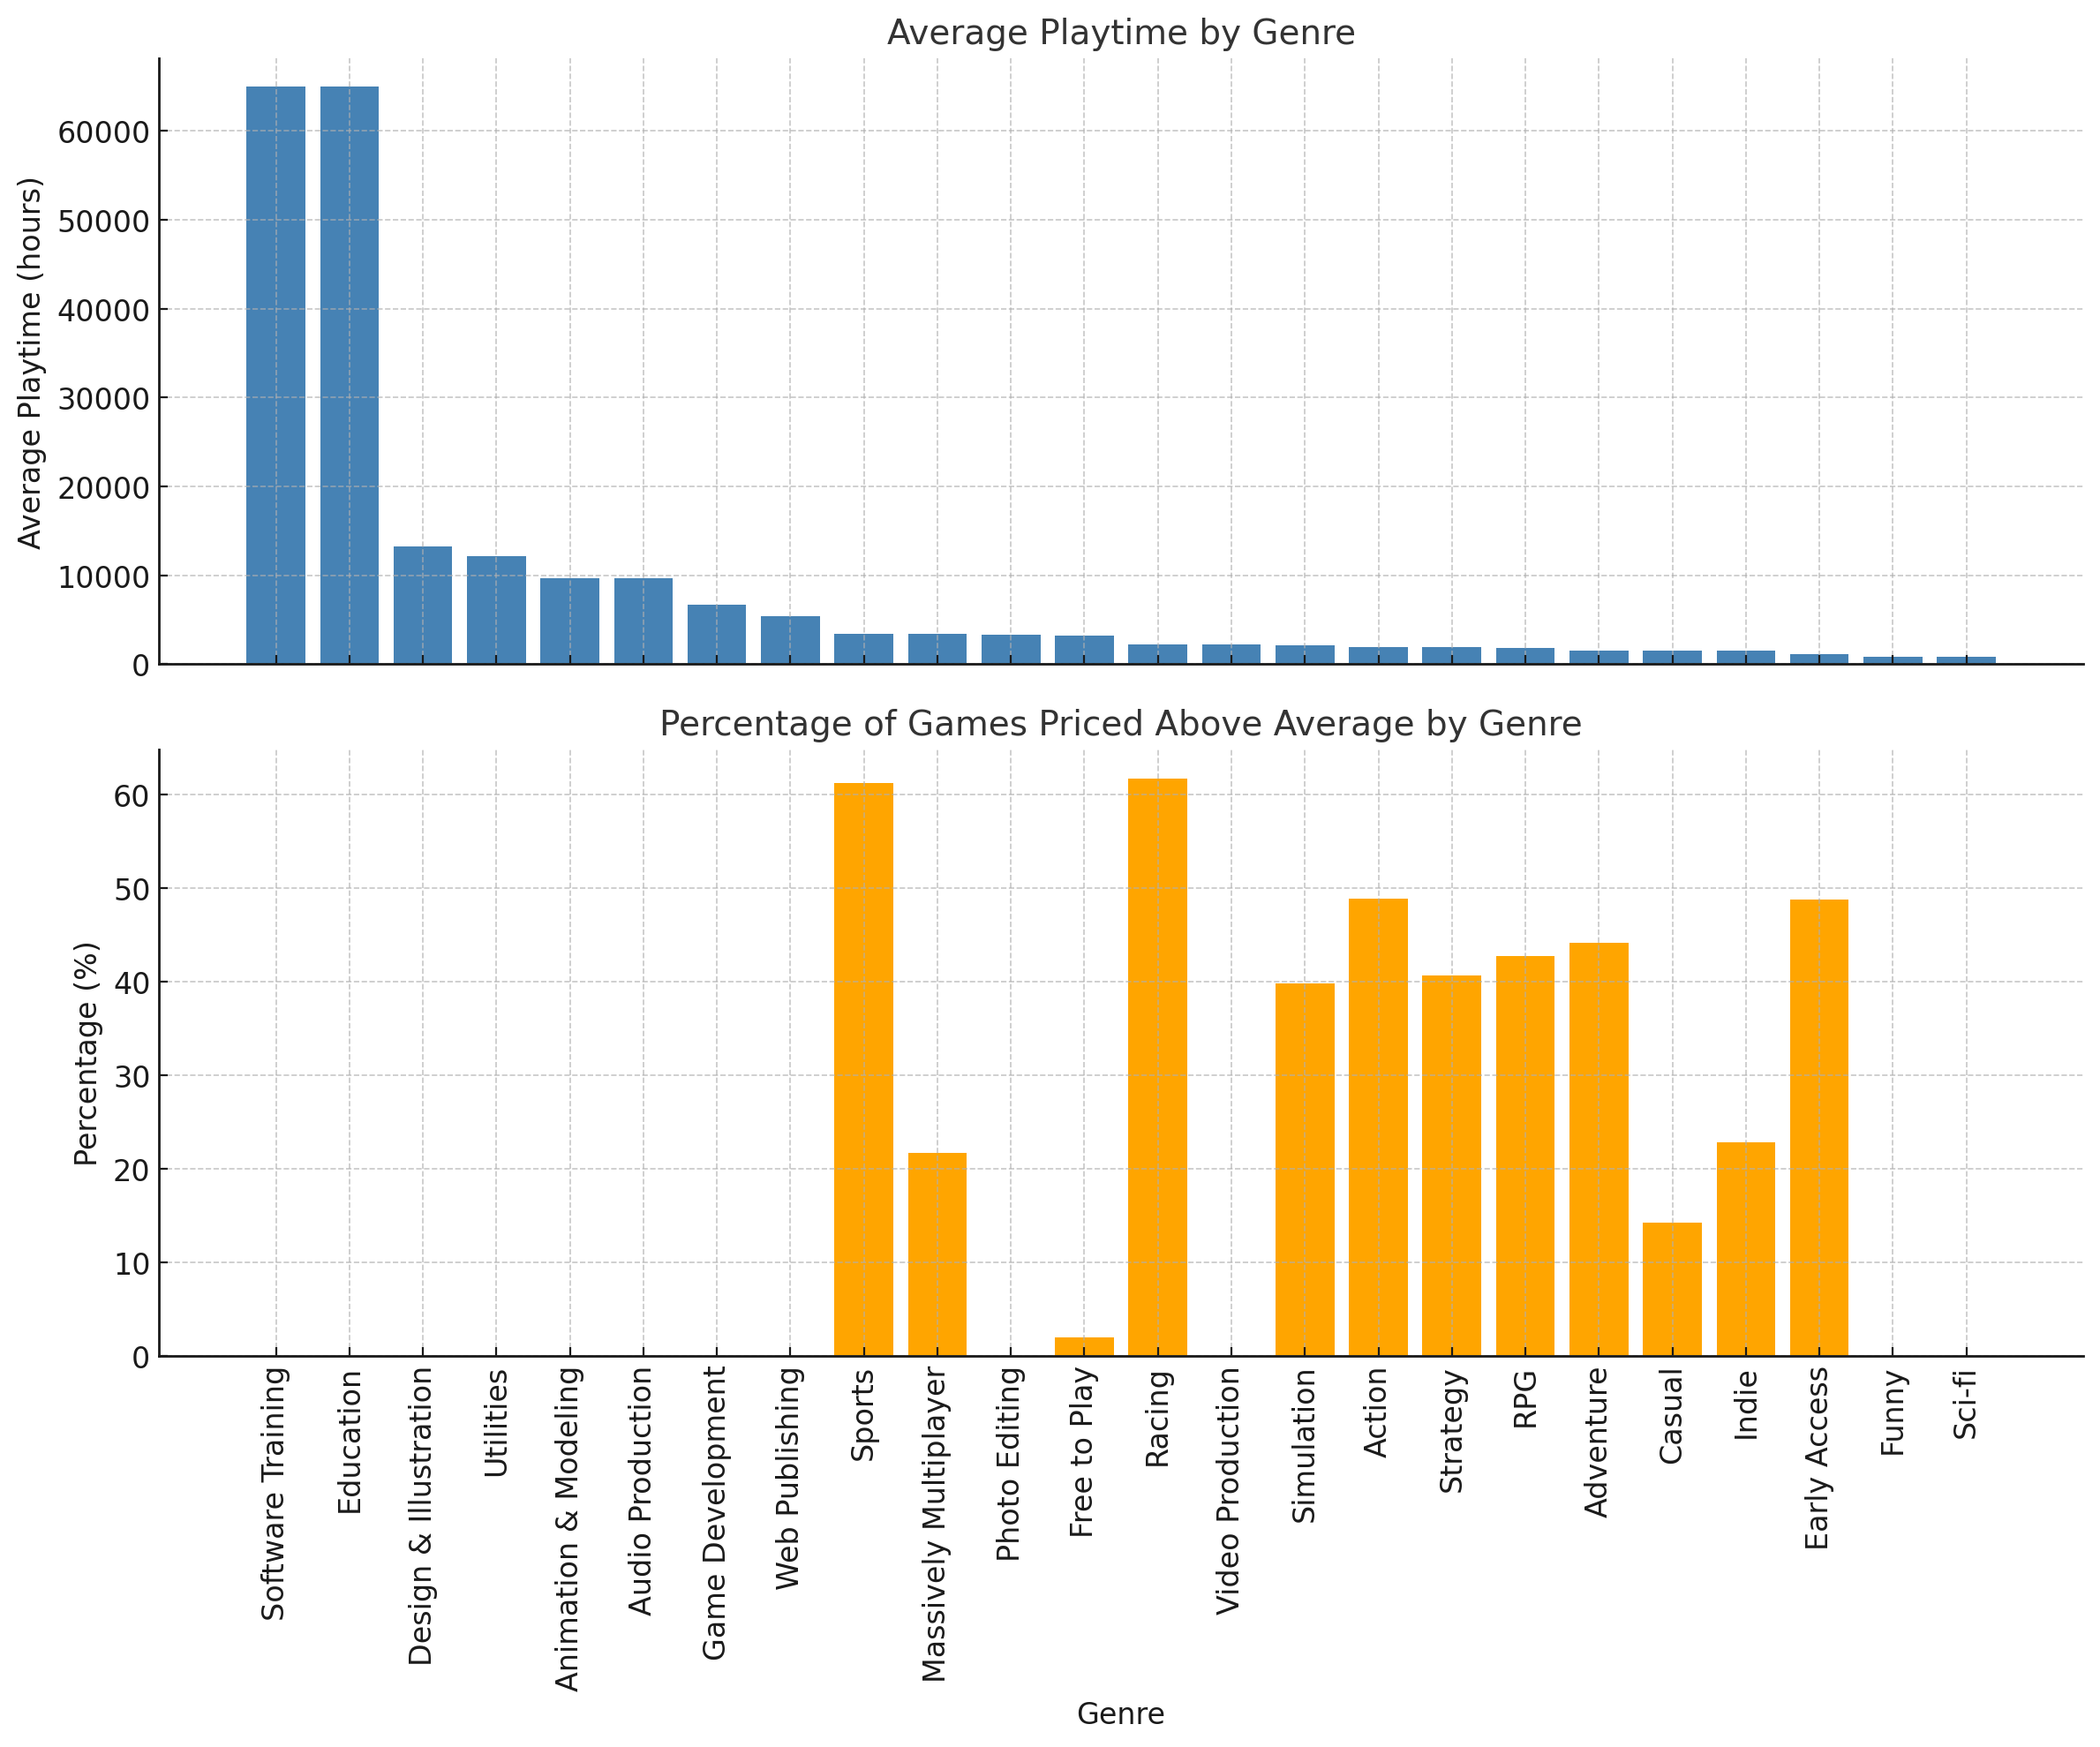
Question 8：
What types of games perform best in terms of average play length and what percentage of those games are priced above the average price of all games?
Software Training and Education lead in average playtime with over 64,000 hours, reflecting their utility-based nature rather than traditional gameplay. Despite their high average playtimes, the top genres like Software Training, Education, and Design & Illustration have 0% of games priced above the average price. This analysis shows that the highest average playtime genres focus on accessibility through lower pricing, emphasizing their utility and professional value over traditional entertainment-driven strategies.

Slide 10
Thank you!

